Slide 1
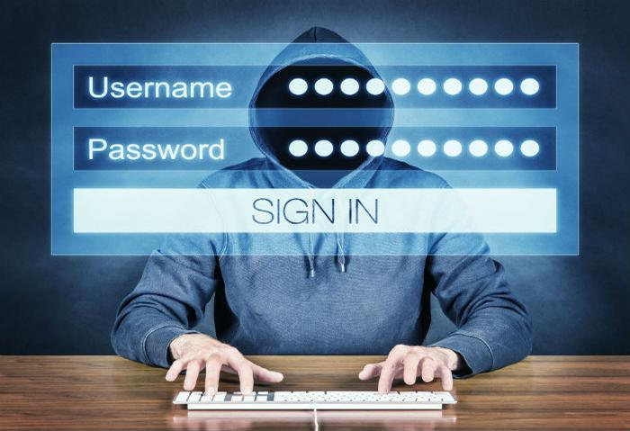
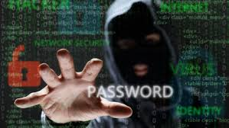

Slide 2
Phishing awareness training with kingphisher tool
Presented by:
Sara Saleem

Slide 3
Overview
Introduction
Why Phishing ?
Installation
Demo of King Phisher
Components of King Phisher
Disadvantages of King Phisher
Features of King Phisher
Real World Example
Other types of Phishing
Prevention from Phishing Attacks

Slide 4
Big Challenge for Organizations
Phishing attack is the most common types of attacks. All are organizations are struggling hard to combat this type of attack on their employees.
International Institute of Cyber Security offers cyber security awareness training program for employees covers every aspect of Phishing attacks with real life demonstrations.

Slide 5

Different Campaign Tools
There are many tools out there to create phishing pages in minutes. So there is always a need of a toolkit that can help organization test there security posture.
Evilginx2, Kingphisher ,Pyphisher ,Gophish , Blackeye
Phishing is a cyber-attack method that involves deceiving individuals and steal his sensitive information such as usernames, passwords, and financial details by posing as a trustworthy entity.
Phishing attacks typically occur through various channels, including emails, text messages, or even social media messages.

Slide 6
Purpose of Phishing
Stealing Personal Information:
Attackers often aim to harvest sensitive personal information such as usernames, passwords, credit card numbers, and social security numbers. This stolen information can be used for identity theft, financial fraud, or other malicious activities.
Credential Theft:
Phishing attacks frequently target login credentials for various accounts, including email, social media, banking, and business accounts. Once obtained, attackers can gain unauthorized access to these accounts, compromising privacy and security.

Slide 7
Purpose of Phishing
Distributing Malware:
Phishing emails often contain malicious attachments or links that, when clicked, can download and install malware on the victim's device. This malware may be designed to steal information, monitor activities, or create a backdoor for further attacks.
Ransomware Attacks:
Some phishing campaigns are specifically crafted to deliver ransomware, a type of malware that encrypts files on the victim's system. The attacker then demands a ransom in exchange for decrypting the files, holding the victim's data hostage.

Slide 8


Slide 9
King Phisher Tool
King Phisher is a phishing campaign toolkit, using this toolkit we can test user’s by sending the malicious link via email using SMTP server and stealing user credentials.
We use king phisher tool for promoting user awareness on real world phishing attacks.
This tool has a user-friendly interface easy to use with multiple campaigns.
This tool is built on python language.

Slide 10
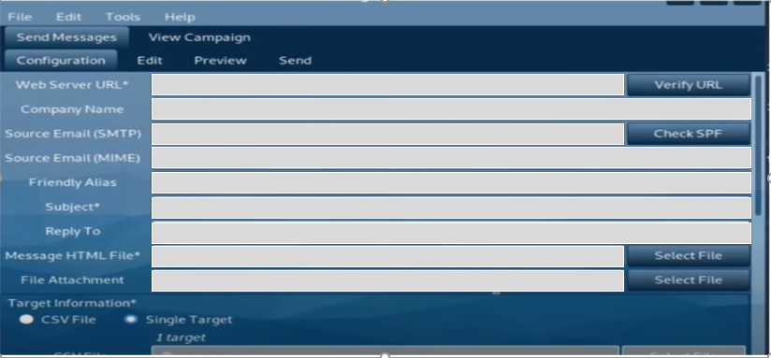
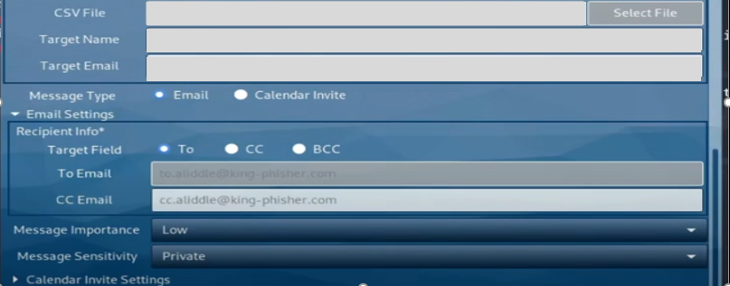
Interface of King Phisher

Slide 11
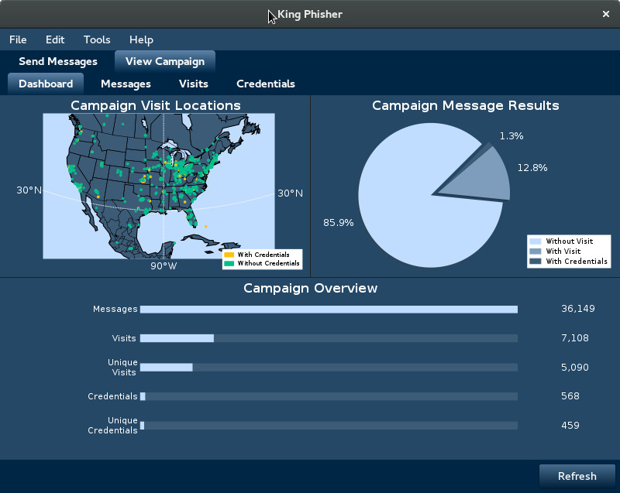

Slide 12

Installation and Demo of Phishing Attack

Slide 13
Installing Dependencies
Terminal Access
Ensure you have access to the terminal in Kali Linux to execute commands.
Python Libraries
Install required Python libraries such as Flask, Jinja2, and psutil.
Additional Packages
Install any additional packages as per the King Phisher documentation.

Slide 14

Demo of King Phisher
Create an Html file for Email Phishing
Configure the tool for Phishing email
Select your target
Send phishing email
Capturing Credentials

Slide 15
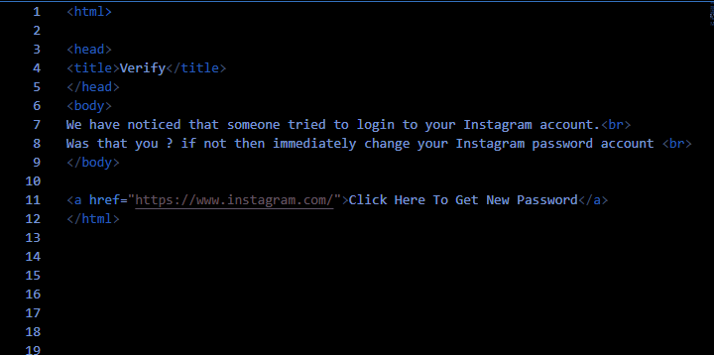
Create an Html file for Email Phishing

Slide 16
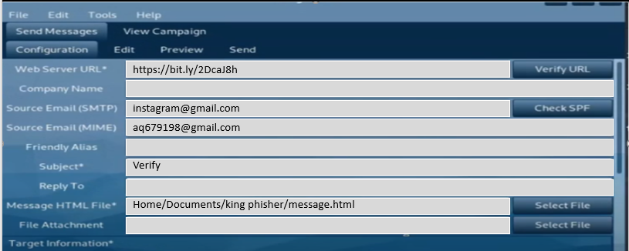
Configure for Sending Email Chose Target

Slide 17
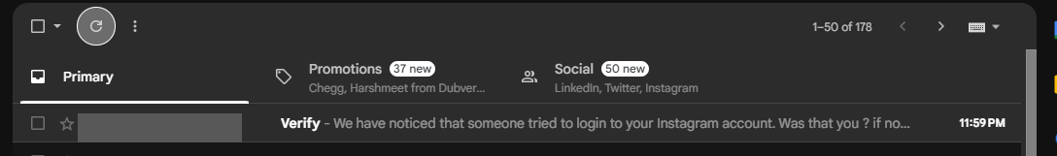
Send Email

Slide 18
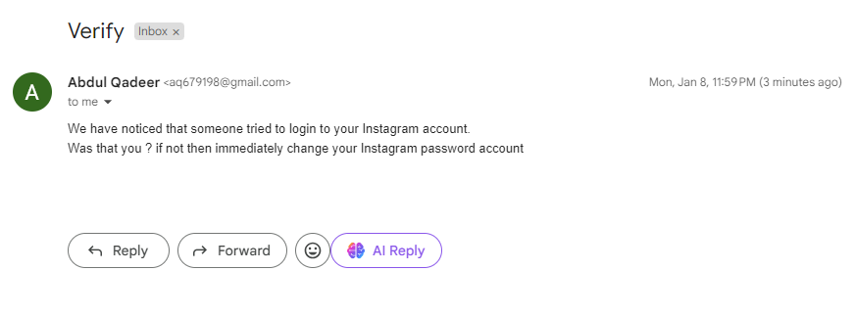
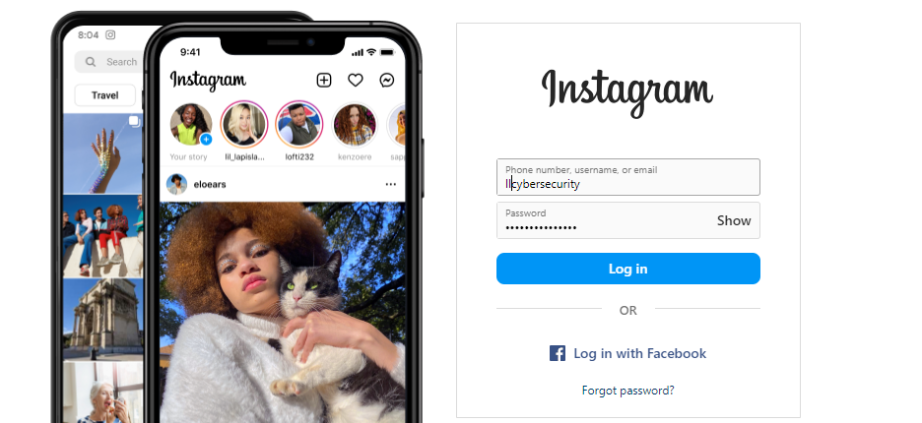

Slide 19
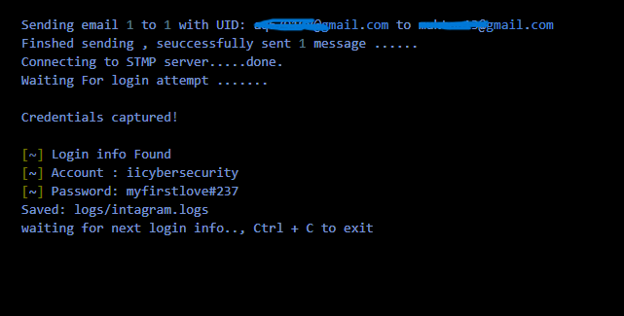
Credentials Captured

Slide 20
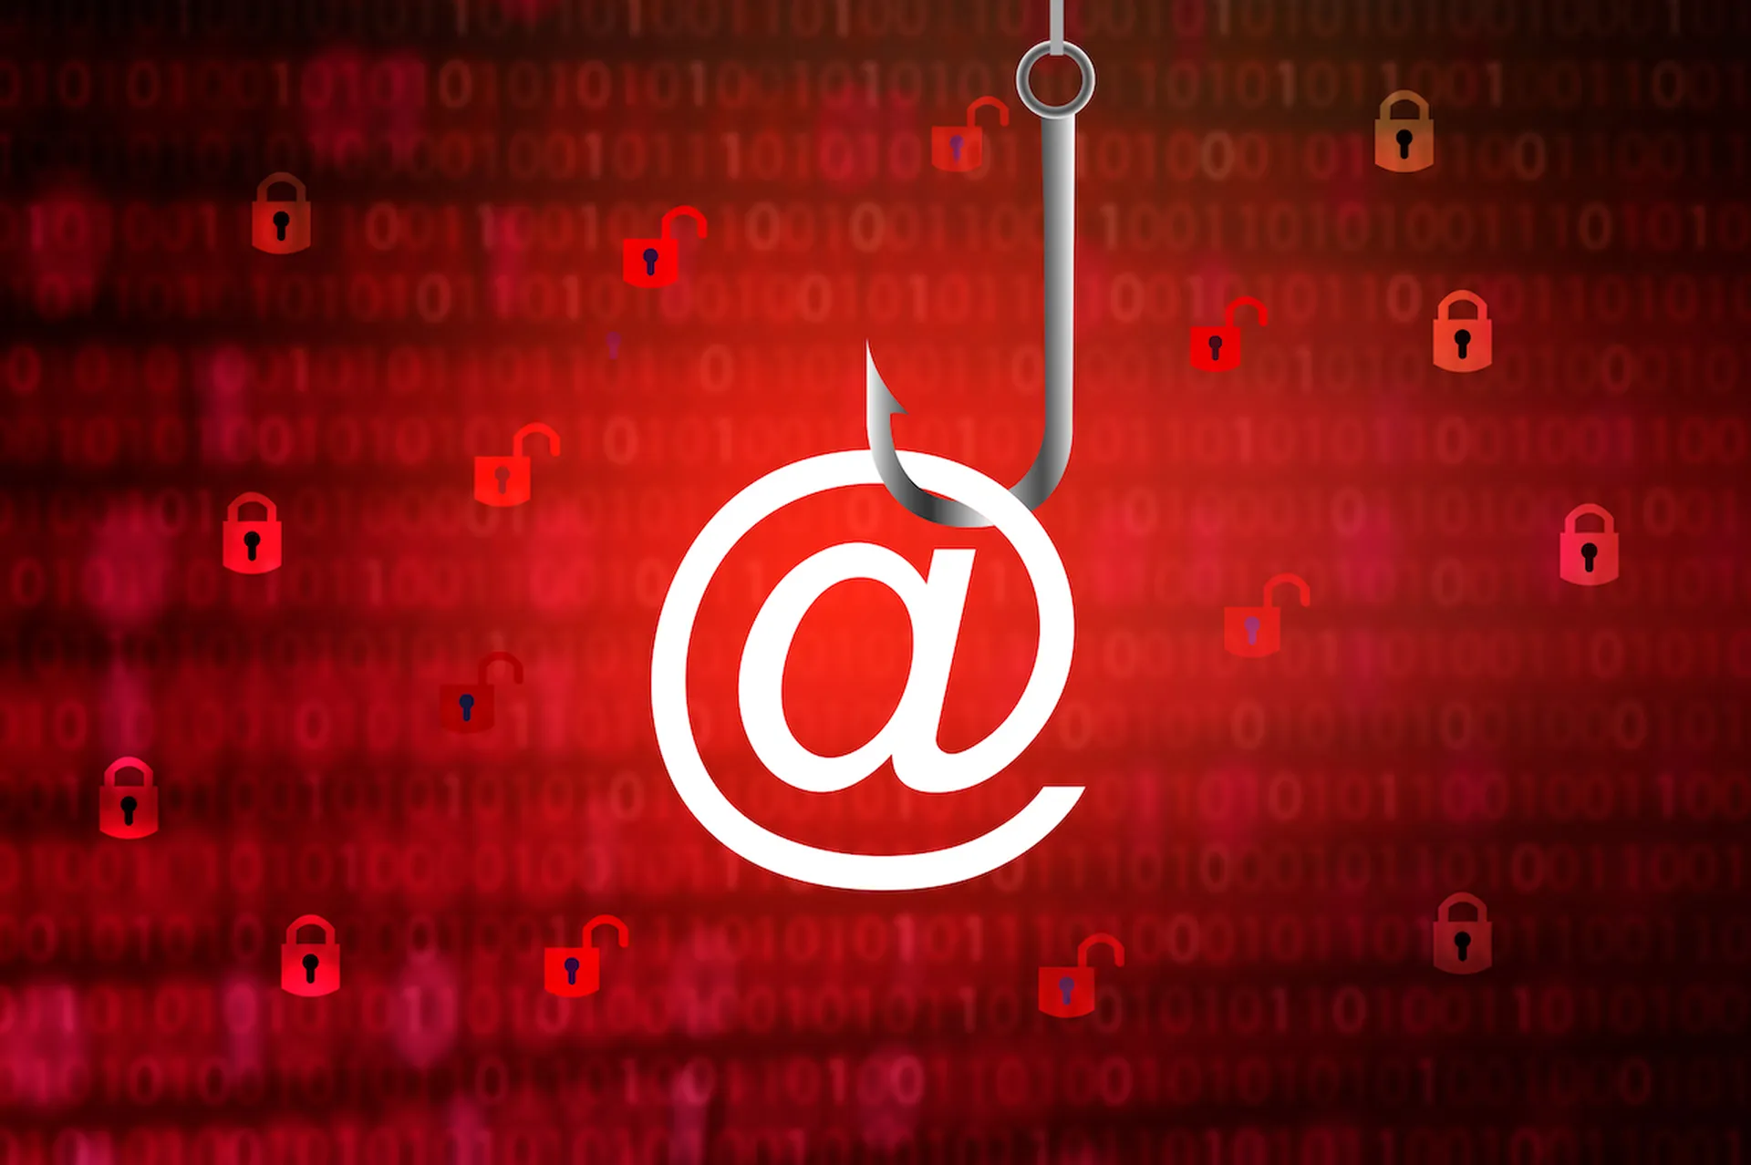
Components of King Phisher and its
Limitations

Slide 21
Client Server Plugins
Server Component:
The server component of King Phisher is responsible for managing and coordinating phishing campaigns.
It includes a web-based management interface that allows users to configure, launch, and monitor campaigns.
The server component typically runs on a system designated as the control server.
Client Component:
In the context of King Phisher, the "client" typically refers to the targets or individuals who are the recipients of the simulated phishing emails.
These clients interact with the emails and potentially with phishing landing pages.

Slide 22
Environment variables of King Phisher
Configuration Files:
King Phisher relies on configuration files to set up parameters for various components such as the server, campaign, and plugins. These configuration files might include settings for the email server, web server, database connection, etc.
Environment Variables:
While King Phisher doesn't explicitly use environmental variables in the way that some software applications or scripts might, it can inherit environmental variables from the operating system. For instance, if you're running King Phisher on Linux, environment variables set in the shell session can affect its behavior.
Database Configuration:
King Phisher uses a database to store campaign data, and the configuration for the database connection is specified in the configuration files. Users may need to set up environmental variables or configuration files for the database connection details.

Slide 23
Disadvantages of King Phisher Tool
Ethical and Legal Concerns:
The primary concern is the potential for misuse. Conducting phishing simulations without proper authorization or explicit consent is unethical and likely illegal. It is essential to comply with legal and ethical standards and obtain consent from participants.
False Sense of Security:
Relying solely on phishing simulations may give organizations a false sense of security. While these tools assess susceptibility to phishing attacks, they do not address all aspects of an organization's overall security posture.

Slide 24
Disadvantages of King Phisher Tool
Outdated Scenarios:
The predefined phishing scenarios in King Phisher may become outdated over time. The tool may not always reflect the latest tactics and techniques used by real attackers, making it important to regularly update and adapt scenarios.
Technical Skill Requirement:
Using King Phisher effectively requires a certain level of technical knowledge. Improper use or misconfiguration can lead to unintended consequences, and users should be aware of the potential risks.
Difficult to Access
King Phisher is mainly supported on Linux OS. In Linux OS, it is also based on Linux packages, like configuration , python libraries. In short , it is difficult to access it.

Slide 25
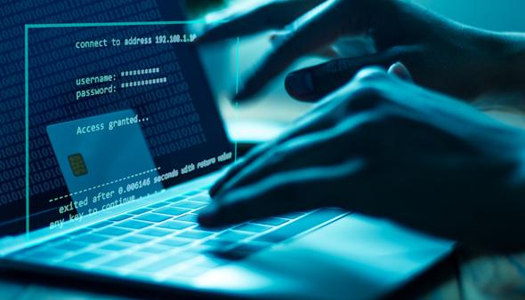
Features of King Phisher , Purpose and Real World Example

Slide 26
Features of King Phisher
Client Server Component
Run multiple phishing campaigns simultaneously
Send email with embedded images for a more legitimate appearance
Optional Two-Factor authentication
Credential harvesting from landing pages
SMS alerts regarding campaign status
Web page cloning capabilities
Integrated Sender Policy Framework (SPF) checks
Geo location of phishing visitors
Send email with calendar invitations

Slide 27
Google Docs as a Victim of Phishing
Real-world example of a phishing attack is the "Google Docs" phishing scam that occurred in 2017.
In this incident, attackers exploited the trust users have in Google's services to deceive them into granting access to their Google accounts.
The attack involved malicious emails sent to Gmail users, appearing to come from a known contact. The email contained an invitation to view a Google Docs document.

Slide 28
Google Docs as a Victim of Phishing
Gain Access to Google Accounts
When users clicked on the link, they were redirected to a legitimate Google sign-in page where they were prompted to select their Google account. this was a phishing page designed to harvest their login credentials.
Once users entered their credentials, the attackers gained access to their Google accounts and could potentially use this information for various malicious activities, such as unauthorized access to sensitive data, spreading malware, or launching further phishing attacks.

Slide 29
Increased Security Measures
Quick Response By Google
Google quickly responded to the incident, taking measures to disable the phishing campaign and improve security measures.
Importance of Incident
The attack highlighted the importance of user awareness, as even seemingly harmless invitations to collaborate on a document can be manipulated for malicious purposes.
It also emphasized the need for organizations to continuously enhance security protocols to defend against evolving phishing tactics.

Slide 30
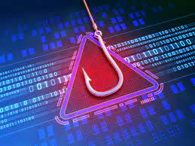
Kinds of Phishing Attack and
Prevention

Slide 31
Kinds of Phishing Attack
Angler Phishing: This is the practice of masquerading as a customer service account on social media, hoping to reach a disgruntled consumer.
Example: if you tweet at your bank about a problem, a scammer might respond pretending to be the bank’s support team and ask you to provide your account details.
Vishing:
Short for voice phishing, it refers to fraudulent phone calls or voice messages designed to trick victims into providing sensitive information.
Example: You might receive a call from someone claiming to be from your credit card company , asking you to give your credit card details.

Slide 32
Kinds of Phishing Attack
Water hole phishing:
It is a target attack in which a cyber criminal compromise a website which is used by a specific group of people.
Example: if you visit frequently a particular forum, a scammer might infect that forum with malware to try to steal information of its users.
Credential Stuffing:
It is a type of cyberattack where attackers steal account credentials, like usernames, email addresses, and passwords.

Slide 33
Prevention from Phishing Attacks
Recognize the sign of phishing
Do not give response to unknown email who is offering you for something.
Report suspicious messages
Use security software
Be cautious with links
Check the email’s header
Install anti-phishing tools
Educate yourself and others

Slide 34
Thank You

